Slide 1
WOMEN AVENGERS GROUP
PROJECT NAME – US RAILTRAFFIC PREDICTION
DATE – JULY 03, 2020
By Ugochi Madumere, Charitha Velamala, Madhu Latha Pasumarthy, Rojakrishna Moparthi, Sreya Mamillapalli, Vidhya Ramamurthy

Slide 2
Table of Contents
Introduction
About the Data Set
Data Exploration
Data Analysis
Conclusion

Slide 3
Introduction
The act of predicting future events and conditions is called forecasting.
Forecasting is predominant for an organization as we can devise a plan for the future events proactively however the circumstances being positive or negative.
Business forecasting is all about predicting the future based on the past data.
This project focuses mainly on data exploration and analysis of US rail traffic data to help predict future load for American Railroad Association.

Slide 4
ABOUT DATASET
We analyzed multiple data sets with diversified data presented to us.
The available data set contained weekly , monthly carload volumes by the American Association of railroads.
It also consisted of monthly and weekly carload data for Canada and Mexico.
There was freight summary data and statistics of US economy data.
We undertook the project to identify 7 months of 2020 data of carload for American railtraffic.

Slide 5
ABOUT DATASET…
AMERICAN RAILROAD TRAFFIC DATA
The presented monthly data is available from Jan 1988 to May 2020.
Weekly data is available from Jan 2009 for U.S and from Jan 2013 data is available for Canada and Mexican carloads however we have taken monthly railroad traffic data for the analysis.
With the help of data exploration and analysis of US rail traffic data ,we wanted to help predict future load for American Railroad Association which will assist them to be prepared for the next 7 months.

Slide 6
DATA EXPLORATION
There are many variables which present data across the different data sets.
From the exploration results we found out that the correlation with freight summary is limited.
Weekly rail data has limited variables compared to rail traffic data.
Canada had stopped recording values after Jan 2016.
There were missing values and outliers in the dataset which were addressed by data transformation.

Slide 7
DATA ANALYSIS
Model detection and evaluation has 4 steps namely tentative identification of the model, estimation, diagnostic checking and forecasting.
396 observations for 24 variables spanning across years 1988 to 2020.
Plotting of time series
Pre-differencing transformation
Stationarity check was done based on Dickey fuller test.
Models ARIMA or Moving average utilized based on the first regular and seasonal differencing across 24 variables
Lags were validated for ACF and PACF.
SAC and SPAC behavior was identified.
Based on the behavior, appropriate model was utilized for each variable to forecast June till Dec 2020 values based on the historic data.
Diagnostic checking was done by validating the p-value related to Chisq and if the standard error, AIC, BIC were less.
Model was found adequate if the above conditions were fulfilled else another model was chosen and executed.

Slide 8
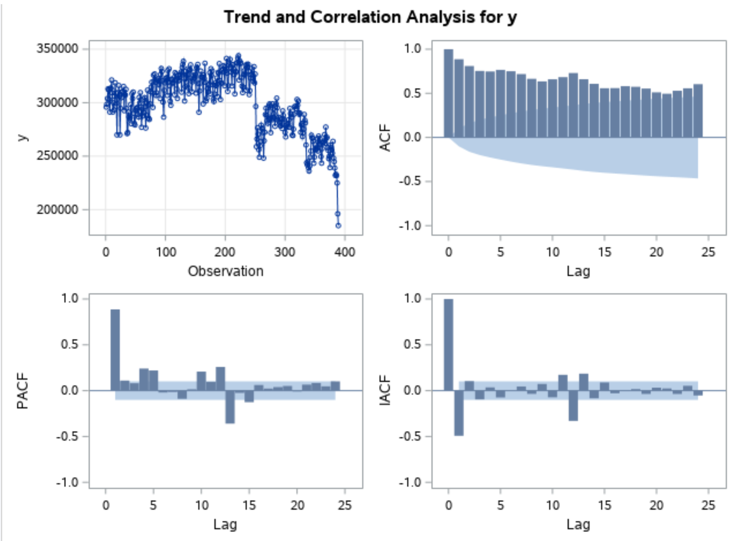
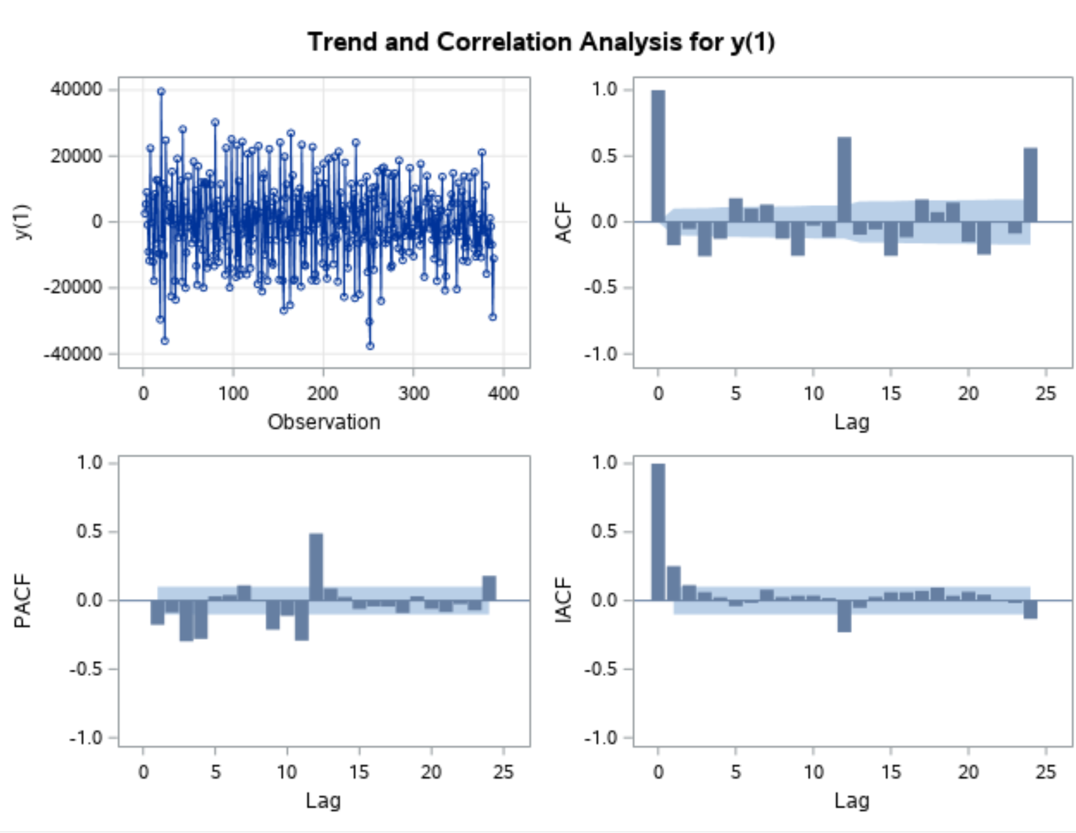
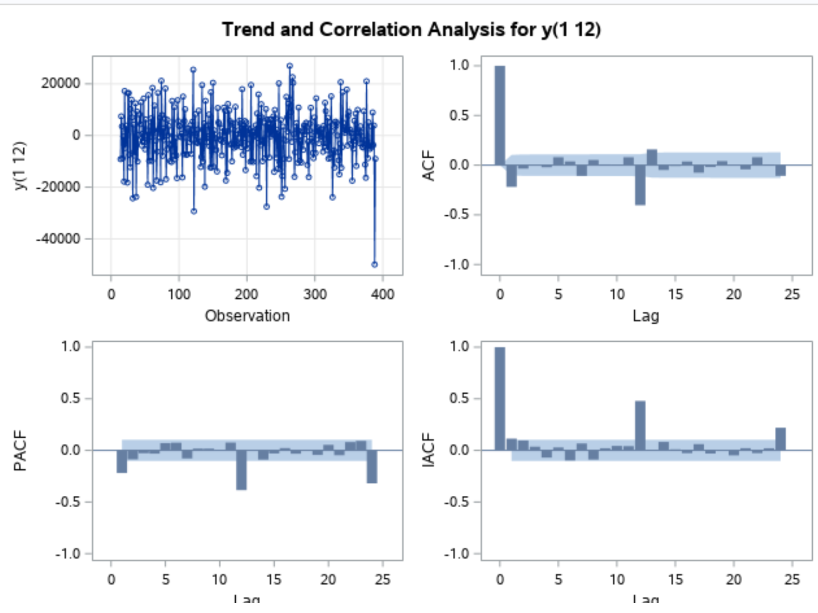
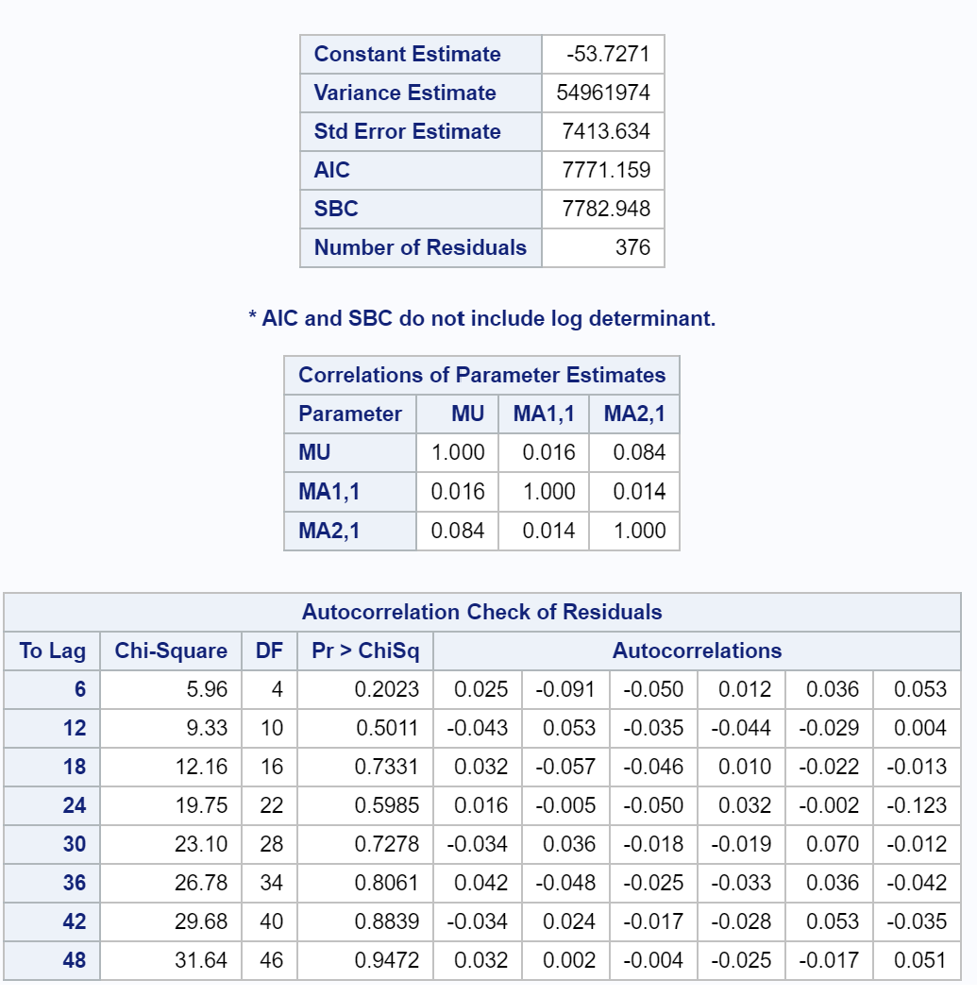
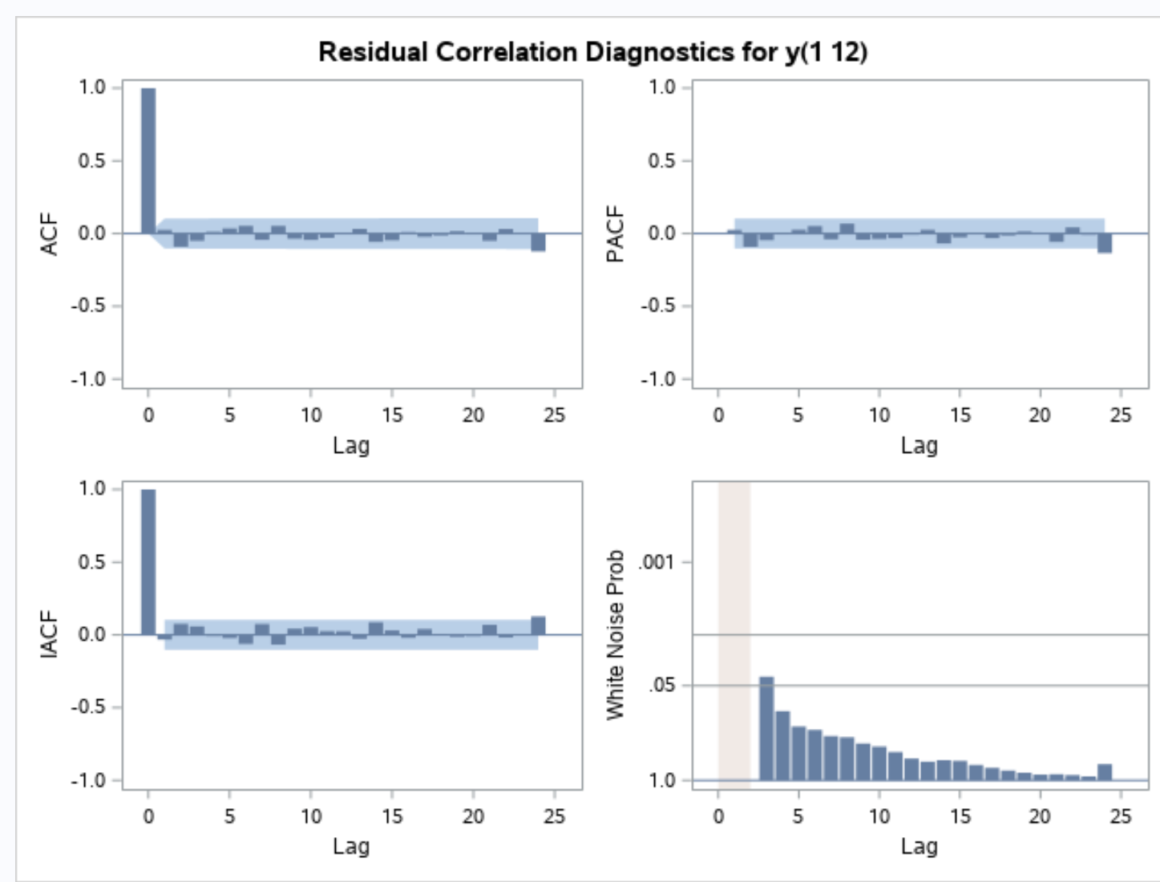
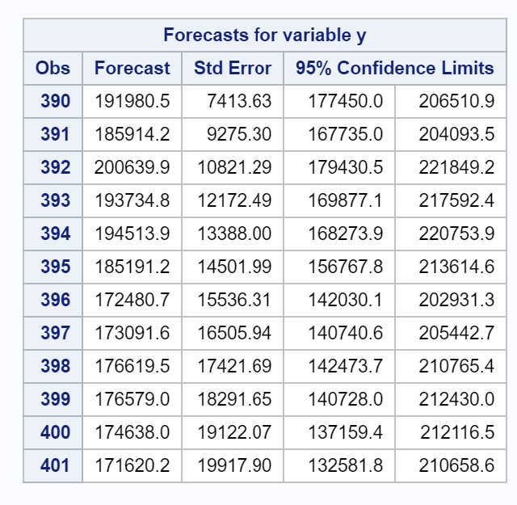
SAS RESULT FOR VARIABLE – TOTAL CARLOAD

Slide 9
Cont…
In the example shown for one variable “Total Carload”
Multiple models were tested
Model chosen was ARMA model with values specified below.
1) ARMA model with values as p+d=(1) and q=(5).
2) ARMA model with values as p+d=(5) and q=(3) and
3) Moving average of order 1 at the nonseasonal variable and 12 at the seasonal variable. q = (1) (12)
Post test, third model was found to be adequate as the pvalue with respect to Chisquare was greater than Alpha set at 0.05
White noise found to be minimal on the third model
Standard error, AIC and BIC was less in comparison to 2 models.
Thus concluded third model appropriate.

Slide 10
CONCLUSION
To Summarize out of various datasets provided due to time constraint American Railroad traffic prediction for next seven months was analyzed and concluded with better identification of the model.
Forecasting was done for total carload initially
We replicated this process of Box-Jenkins method across 23 other variables by doing an extensive research.
Similar to carload, 23 other variables model was identified and forecasted for June until December 2020.
Although there are external factors like Covid-19 which could affect the predicted dataset.
In the forth coming slides we will show how the data represented for the next seven months and overall volumes of US Rail traffic carload.

Slide 11
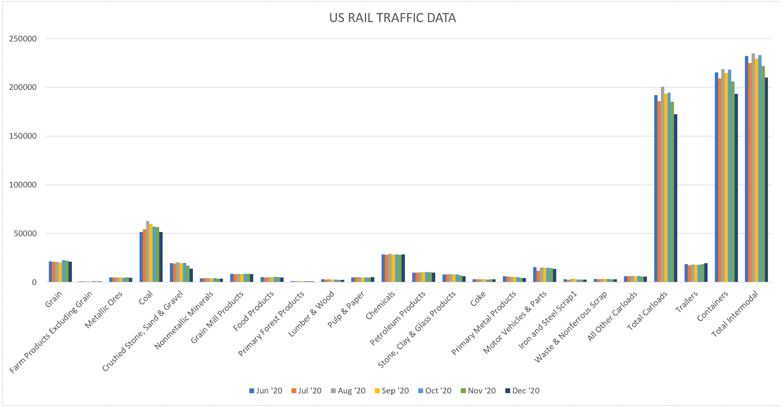
CONCLUSION…..
Below representation is the 24 variables for the remaining 7 months of 2020 predicted.

Slide 12
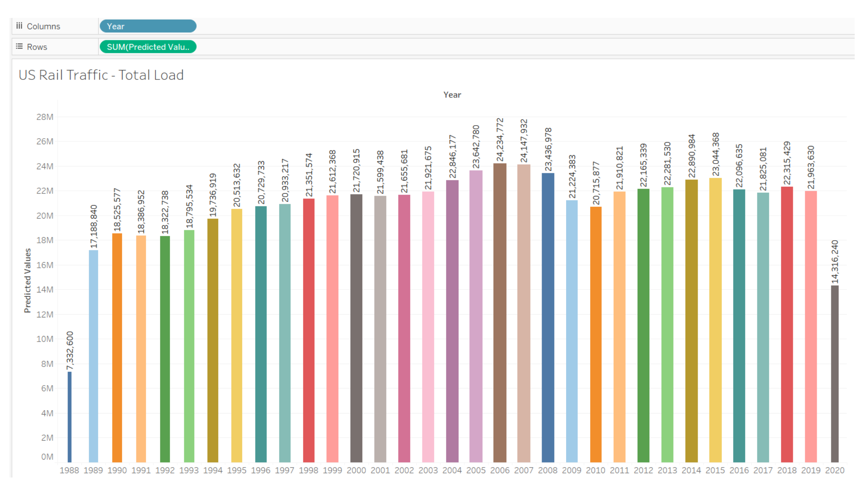
Tableau Representation

Slide 13
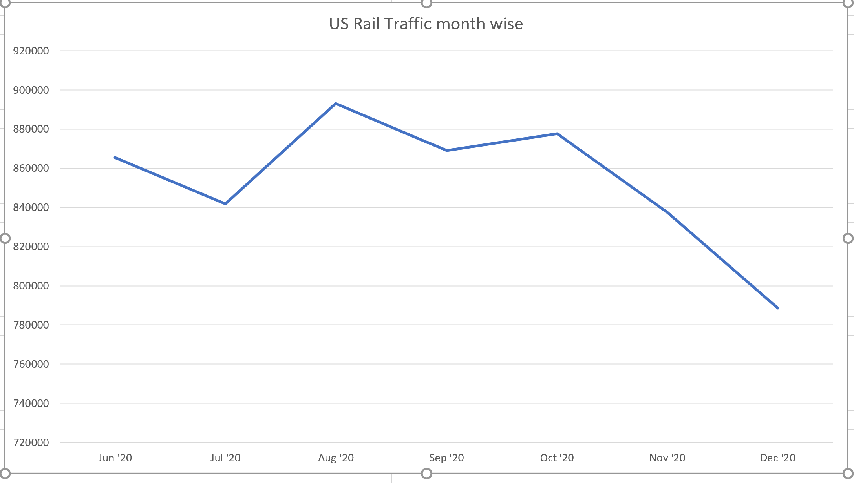
CONT….
In addition the overall volumes of rail traffic carload have an increase in August and identified a declining trend for December.
From the above project we would like to state that the Box-Jenkins model identifies the tentatively better model to predict future of the upcoming events based on the past data.

Slide 14
THANK YOU

